Slide 1
CIBIL Report Analysis
Mentor: Prof. Ratnakar Pandey
Presented By:
Amit Kavnekar
Madhukeshwar K
Anand Mohan
Hitesh
Tonima Paul

Slide 2
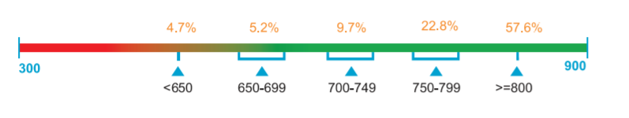
CIBIL Score
CIBIL Score is a 3 digit numeric summary of your credit history & ranges from 300 to 900.
One of the factors which affects CIBIL Score depends on is the timely payments made towards the outstanding loans and credit cards. If anything missed in a payment in the last 24 months, it will lead to account being delinquent. Any delinquency will have a negative impact on CIBIL Score. One way to improve CIBIL Score is to make payments before/by the due date. This will prevent account from getting delinquent and will subsequently have a positive impact on CIBIL Score.

Slide 3
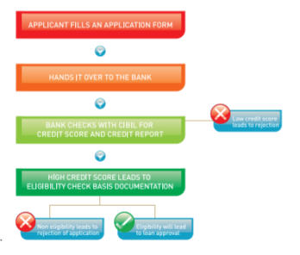
Importance of CIBIL Score
CIBIL Score is the first check that a lender does when they are evaluating loan application. It’s important to know that nearly 90% of the loans are granted for individuals with score greater than 750.
The higher CIBIL Score, the higher are the changes of loan getting approved.
Loan eligibility is determined using information such Income, Current EMI’s and Credit Score. Once a credit score meets the lenders internal credit policy criteria, they then analyze the documents to understand some key points before approving loan application.

Slide 4
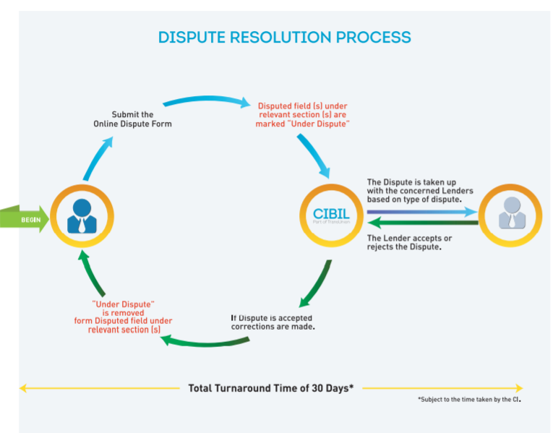
Disputes
Types of disputes / error than be raised with CIBIL.
Personal Information : Information such as Name, Date of Birth, Pan Card, Address etc.
Account Information : Information such as Account/Loan Type status, date of last payment, current payment, amount overdue etc can be disputes.
Ownership : Make sure all personal details and accounts belong to same person. If an account does not match, raise the dispute.
Duplicate Account : If the same account is reflecting more than once it can be get retified.

Slide 5
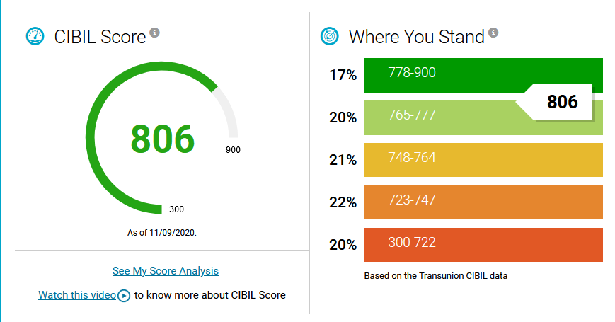
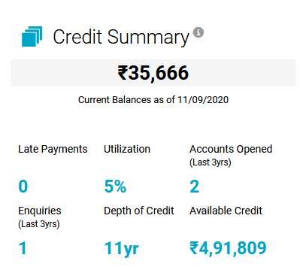
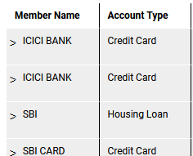
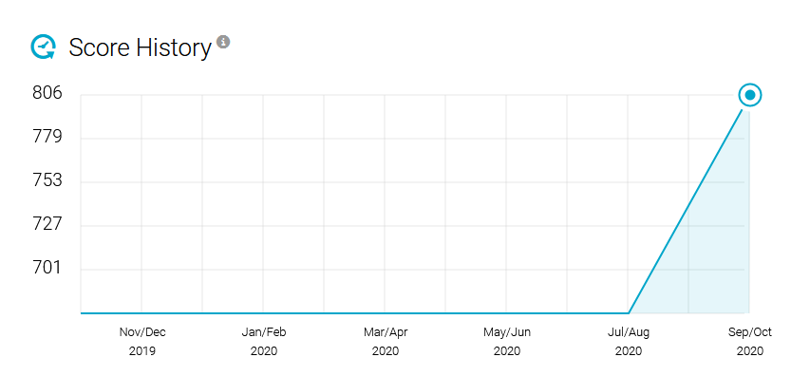
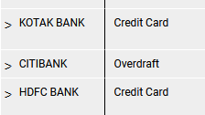
Credit Information:
Observations:
The CIBIL score is 806 on 11 sept 2020
We see sharp rise in CIBIL score since July/Aug 2020
5% utilization of available credit limit
11 Years of credit History

Slide 6
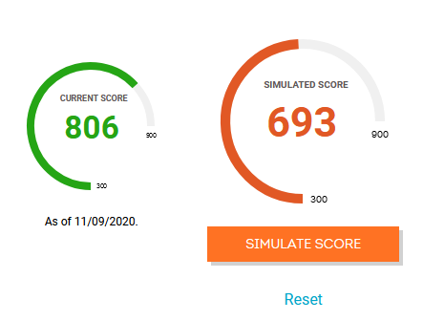
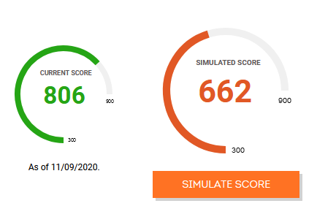
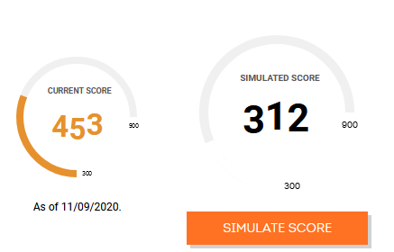
Default on all loans for 30 days
Simulating Various credit Scenarios:
Default on all loans for 60 days
Observations:
If all loans are defaulted in past 30 days CIBIL score will be reduced to 693
If all loans are defaulted for last 60 days CIBIL score will be reduced to 662
If all outstanding loans are defaulted for 90 days the CIBIL score will be reduced to 312
*The longer you go on defaulting on your loans the CBIL goes on reducing more and more rapidly
Default on all loans for 90 days

Slide 7
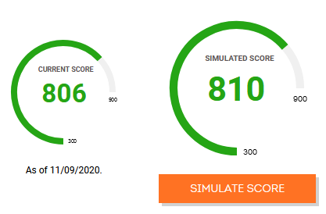
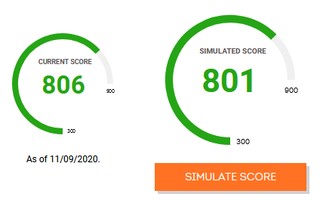
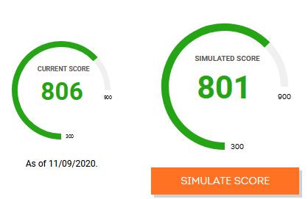
Add a new home loan of 50 Lakh
Simulating Various credit Scenarios:
Observations:
If we add take an additional Home loan of 50 Lakh CIBIL score will increase to 810
If we take Automobile loan of 10Lakh CIBIL score will be reduced to 801
If we take personal loan of 10Lakh CIBIL score will be reduced to 801
Add new Auto loan of 10 Lakh
Add new Personal 10 Lakh

Slide 8
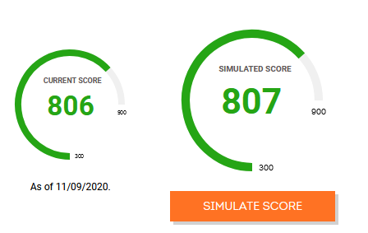
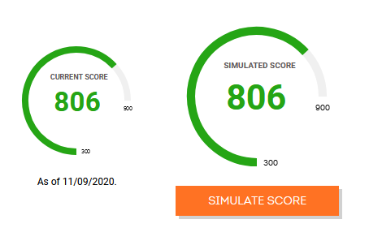
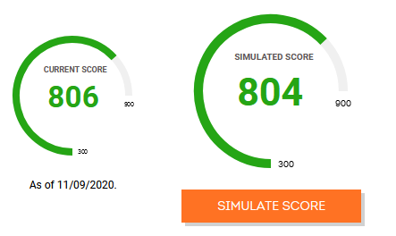
Clear all outstanding payments
Simulating Various credit Scenarios:
Observations:
If we clear all outstanding credits CIBIL score will increase to 807
If we close oldest credit card CIBIL score will remain unchanged
If we take a new credit card with 2 Lakh credit limit the CIBIL score will be reduced to 804
Close oldest credit card
New credit card with 2 Lakh limit

Slide 9
factors that have a negative or positive effect on the CIBIL report
Payment History: 35% :
Paying late has a negative effect on your score. If you've paid late, how late were you—30 days, 60 days or 90+ days? The later you are, the worse it is for your score. Have any of your accounts been sent to collections? This is a red flag to potential lenders that you might not pay them back.
Serious payment issues, like charge-offs, collections, bankruptcy, repossession, tax liens, or foreclosure can devastate your credit score.
The time since the last negative event and the frequency of missed payments affect the credit score deduction. Someone who missed several credit card payments five years ago, for example, will be seen as less of a risk than a person who missed one big payment this year.
2. Amounts Owed: 30%:
Don’t assume you have to have a $0 balance on your accounts to score high marks here. Less is better, but owing a little bit can be better than owing nothing at all because lenders want to see that if you borrow money, you are responsible and financially stable enough to pay it back.
The amount of overall debt you carry, the ratio of your credit card balances to your credit limit (also called credit utilization), and the relation of your loan balances to the original loan amount.
You should keep your credit card utilization at 30% or less, meaning only charge up to 30% of any card's available limit. Having high balances or too much debt can heavily affect your credit score.

Slide 10
factors that have a negative or positive effect on the CIBIL report
Length of Credit History: 15%
A long credit history is helpful (if it's not marred by late payments and other negative items), but a short history can be fine too as long as you've made your payments on time and don't owe too much.
It considers both the age of your oldest account and the average age of all your accounts. Having an "older" credit age is better for your credit score because it shows that you have a lot of experience handling credit.
Opening new accounts or closing existing accounts can lower your average credit age. For that reason, it's typically not a good idea to open several new accounts at once.
Types of Credit in Use: 10%
It is important to maintain a healthy balance of secured and unsecured loans. Home loans and auto loans are examples of secured loans while a credit card is an example of an unsecured loan.
If you have a high number of only one type of credit, it can affect your score. Also, when you have a healthy mix of different types of loans, it suggests that you have experience in handling both different types of loans. This is considered desirable by lenders.
Two basic types of credit accounts exist, revolving accounts and installment loans. Having both types of accounts on your credit report is better for your credit score because it indicates you have experience managing various types of credit.
Making Multiple Credit Applications
Errors in your CIBIL Report
Number of Credit Inquiries.

Slide 11
Factors that do not affect your CIBIL Score:
Your investment schemes and account balance
Bounced or stop payment cheques – Though it is true that every delayed or bounced payment get directly reported to the CIBIL, it doesn’t affect your CIBIL score. Your bounced cheques are not a part of your credit report and thus, they have almost near-to-zero impact on your CIBIL score, unless the cheques is not related to any loan installment or repayment.
Accounts that are not operative or more saving accounts
Transactions made by debit card
Checking your CIBIL score again and again
Your postponed utility bills- If you have any due utility bills like electricity, house tax, and mobile phone bills, then it is not going to affect your CIBIL score. But, it is definitely going to hamper your other personal factors. Because being a defaulter is not at all a good thing.
Your change in income
Your demographics- Change in address, change in marital status, education level, religion, and various other factors do not affect your CIBIL score.
Being denied to credit- Being denied the loan and credit cards does not affect your CIBIL score, but being denied to give a “Closed” deal might affect it.

Slide 12
recommendations to improve credit score :
Check Your Credit Report: Checking your Credit Report is a good idea because it will tell you two things that are absolutely critical to your credit score. The first thing will be the loans or credit cards where the defaults or delayed payments exist that have brought down your credit score. The second thing is, it will help in fixing the credit score because if you notice that there is negative information about your credits, in the form of defaults or delays in payments, you can always approach the bank and CIBIL to get the situation corrected.
Eliminate Your Credit Card Balance: Only spend as much amount as you can repay within the billing date. By balances, also mean any unpaid dues on loans and EMIs.Also, it is better to have just one or two credit cards so that it becomes easier for you to keep track of repayments.
Dispute Inaccuracies: As mistakes can happen from any side. Even lenders can also make errors at the time of data entry. It is compulsory for any financial institution to act on those disputes within 30 days. Once the error is resolved, it will show improvement in your CIBIL or credit score.
Keep Old Debt on Your Report: Many of us believe that old debt accounts that we are not using any more should be closed. Good debts are the debt that you’ve handled well and paid in accordance to agreed terms. The longer your history of good debt is, the better it is for your credit or CIBIL score.
Pay EMI on Time: This is one of the important things that CIBIL or other credit scorer looks into while gauging your credit ratings.

Slide 13
recommendations to improve credit score :
Maintain a balanced Credit Utilization Ratio: If you have used over 50% of your credit limit, it can have a negative effect on your score. Having a high credit exposure indicates you are at a higher risk of defaulting.
Do not make Multiple Credit Applications: When you apply for a loan or a credit card, lenders will want to check your creditworthiness and they’ll do this by pulling out your credit report. This is called a hard inquiry. If you send out multiple applications, it will mean that multiple credit inquiries are occurring around the same time. These hard inquiries are reported and affect your score negatively. It will make you look credit hungry. If your loan or credit card application has been rejected recently, it is advised to not apply for credit immediately. It is better to improve your CIBIL score and then apply again.
Maintain a healthy balance of secured and unsecured loans.: Home loans and auto loans are examples of secured loans while a credit card is an example of an unsecured loan. This is considered desirable by lenders.
Maintain a long Credit History: It is better to focus on building a credit history in the earlier stage of life as, by the time you apply for a home or car loan, you will have a good record of credit transactions.
Avoid Closing old Credit Card Accounts: when you close your old accounts, you end up losing a long credit history associated with it. Therefore, if you have used the card for a substantial number of years, it is advised to keep it open as long as possible, if feasible. Consider closing a card that is relatively new.

Slide 14
recommendations to improve credit score :
Don’t Hint at Risk: Sometimes, one of the best ways to improve your credit score is to not do something that could risk it.Two of the biggest risk that you can take is on missing payments and suddenly paying less than you normally do.You just don’t want to do anything that would indicate risk for your creditworthiness.
Demonstrate the Reliability of Bill Payment: Although your credit report does not include information about your payment of utility bills (electricity, water or gas) or phone bills (home, mobile, and internet) in general, it is important to pay these bills when they’re due.
Increase your Credit Limit: When you ask your bank to raise your credit limit, particular for credit cards, it does not necessarily mean that you get a chance to spend beyond your means. This increase in credit limit can have a number of plus points if you manage your credit wisely.
Watch out for Joint Applicants: In such scenario, if you are the joint application for a loan someone else has taken, and they have defaulted on payments then you too will lose out in your CIBIL or credit score as it will reflect in your report too.

